Slide 1
Course Introduction
Welcome to ENGL 3110

Slide 2
Review
  What are the three English “Auxiliary” Verbs?
  What are the four “aspects” of English Verbs
    How are these aspects conjugated in present tense?
  How do you apply past tense to a sentence with grammatical aspect?
    Which word becomes past tense?

Slide 3
Review
Subject | Past Tense | Perfect Aspect | Progressive Aspect | Main Verb
 | (Past Tense) | + Have (Past Participle) | + Be (Present Participle)
I | Y | Had | Been | Walking
I | --- | Have | Been | Walking
I | Y | Had | --- | Walked
I | --- | Have | --- | Walked
I | Y | --- | Was | Walking
I | --- | --- | Am | Walking
I | Y | --- | --- | Walked
I | ---- | --- | --- | Walk

Slide 4
Review
Subject | Past Tense | Perfect Aspect | Progressive Aspect | Main Verb
 | (Past Tense) | + Have (Past Participle) | + Be (Present Participle)
I | Y | Had | Been | Throwing
I | --- | Have | Been | Throwing
I | Y | Had | --- | Thrown
I | --- | Have | --- | Thrown
I | Y | --- | Was | Throwing
I | --- | --- | Am | Throwing
I | Y | --- | --- | Threw
I | ---- | --- | --- | Throw

Slide 5
Review
Subject | Past Tense | Perfect Aspect | Progressive Aspect | Main Verb
 | (Past Tense) | + Have (Past Participle) | + Be (Present Participle)
I | Y | Had | Been | Going
I | --- | Have | Been | Going
I | Y | Had | --- | Gone
I | --- | Have | --- | Gone
I | Y | --- | Was | Going
I | --- | --- | Am | Going
I | Y | --- | --- | Went
I | ---- | --- | --- | Go

Slide 6
Review
Subject | Past Tense | Perfect Aspect | Progressive Aspect | Main Verb
 | (Past Tense) | + Have (Past Participle) | + Be (Present Participle)
I | Y | Had | Been | Being
I | --- | Have | Been | Being
I | Y | Had | --- | Been
I | --- | Have | --- | Been
I | Y | --- | Was | Being
I | --- | --- | Am | Being
I | Y | --- | --- | Was
I | ---- | --- | --- | Am

Slide 7
Diagraming
Review Diagrams for Modals and Auxiliaries
Explain “Main Verb Phrase” option

Slide 8
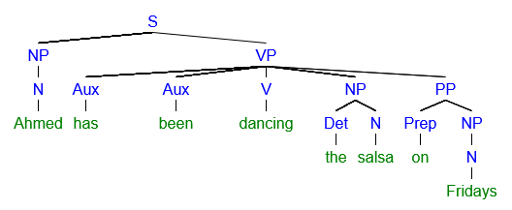
Diagraming
Adding Auxiliary Verbs without an MVP (main verb phrase)

Slide 9
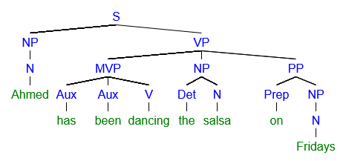
Diagraming
Adding Auxiliary Verbs with an MVP (main verb phrase)

Slide 10
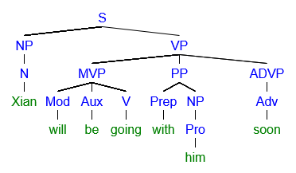
Diagraming
Adding Modals with an MVP (main verb phrase)

Slide 11
Diagraming
Create a sentence of each type below
Diagram that sentence and include a “main verb phrase”
  A sentence in past perfect progressive
    (Past tense, perfect progressive aspect)
  A sentence with “do” as an auxiliary verb.
    Example – “I do believe in ghosts.”

Slide 12
Homework
Homework Check

Slide 13
Homework
Why Use Passive Voice
  Can create cohesion and emphasis by flipping the order
    Student loans are terrible. They are collected even if you don’t graduate.
  Can avoid laying blame or responsibility
    The membership may be voided if terms are violated.
    The curse was activated, laying the town to waste.
  Sometimes the actor is unknown or unimportant
    The jeweled necklace was stolen.
    A delicious meal has been prepared in advance.
  Creates a sense of scientific objectivity or inevitable processes
    Students were surveyed about their mental health.
    The universe had not been affected by heat death.

Slide 14
For Thursday
Modals – On Test
  I won’t go to the store.
Diagramming Verb Phrase Practice – On Test
Phrasal Verbs – Not on Test
  “I had been giving up running”
  “You better slow down.”
Semi-modals – Not on Test
  She used to be a teacher.
  “I am gonna catch a cold.

Slide 15
End of Class
If you have questions or concerns, hang around to talk.

